Slide 1
Adirondack Tree guide
http://www.esf.edu/aec/adks/forestcomm.htm

Slide 2
Evergreens (softwood) (coniferous) #1 Flat needle (hemlock, fir, cedar)

Slide 3
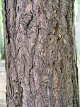
Eastern Hemlock Tsuga canadensis
Needles grow on opposite sides of the branch and are smaller than fir needles
Needles attached to the twig with a small stem.
Fir has no stem, but the longer needles are attached by what might look like tiny suction cups.
Both fir and hemlock have white lines on the underside of the needles.

Slide 4
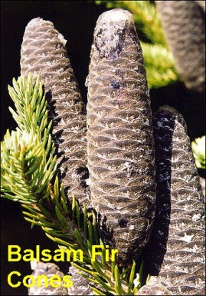
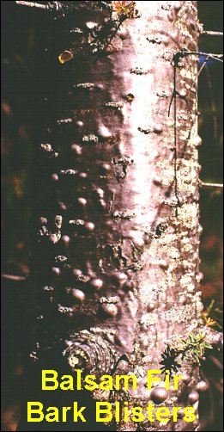
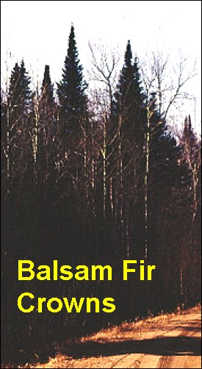
Balsam Fir Abies balsamea
NEEDLES =3/4 to 1-1/4 inches long with two white stripes
CONES grow at the top of the tree
BARK = smooth and steely gray often bubbly (bubbly bark – balsam)
Balsam fir will grow on a variety of wetland and upland SITES.

Slide 5
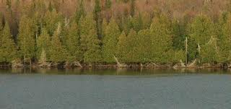
Eastern White Cedar Thuja occidentalis
Flat scalelike needles
Flaky bark
Grows near water
Tea prepared from the bark and foliage → vitamin C
Favorite food for white tailed deer

Slide 6
Evergreens #2 Pointed needles single needles (spruce)

Slide 7
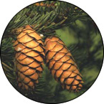
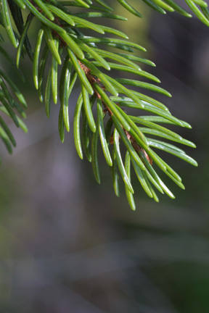
Red Spruce (Picea rubens)
It often grows at high altitudes
Likes moist soils
Bark is lighter than black spruce
Sharp Needles, curved, four-sided, at sharp angles from twig
Very shade tolerant

Slide 8
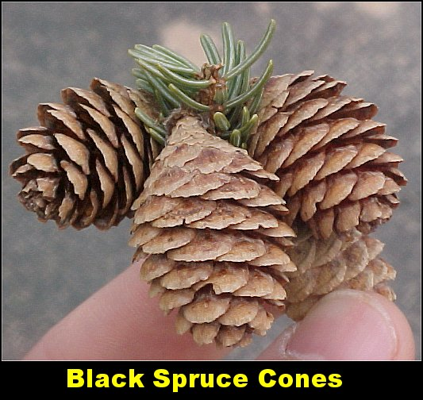
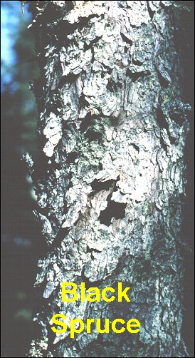
Black Spruce Picea mariana
Very similar to red spruce but tends to grow in swampy areas
Scaley bark is dark grey

Slide 9
Evergreens #3 Needles in clusters (Pines)

Slide 10
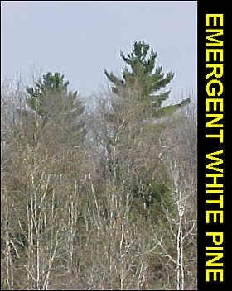
Eastern White Pine Pinus strobus
Needles in clusters of 5
The BARK on young trees (under 4-5 inches) is steely gray and mostly smooth.
The bark gradually becomes deeply ridged as the tree get larger
often grow very tall in well drained soils

Slide 11
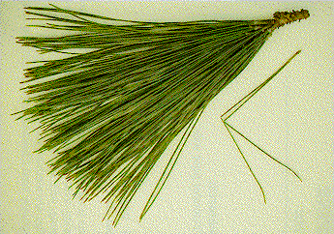
Red pine Pinus resinosa
Reddish scaley bark
Needles in cluster of 2-3
Red Pine is commonly found on sandy, well-drained soils. After fire or logging, Red Pine establishes itself in pure stands or mixed forests.

Slide 12
White vs. Red Pine

Slide 13
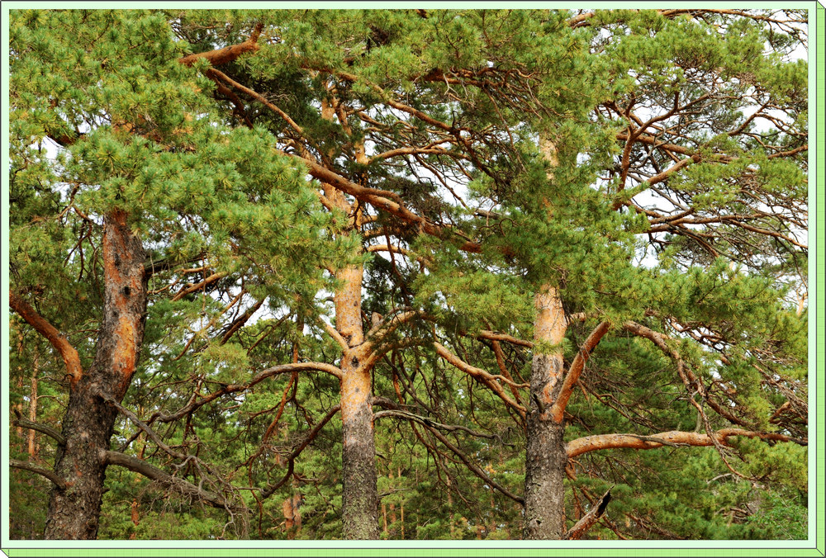
Scotch Pine
Non-native tree similar to red pine
Needles in clusters of 2
Tops of mature trees look like they’ve been stripped of bark → orange color
http://www.treesflowers.com/trees-flowers/y2010-10072-mongolian-scotch-pine-pictures.html

Slide 14
Deciduous Conifers

Slide 15
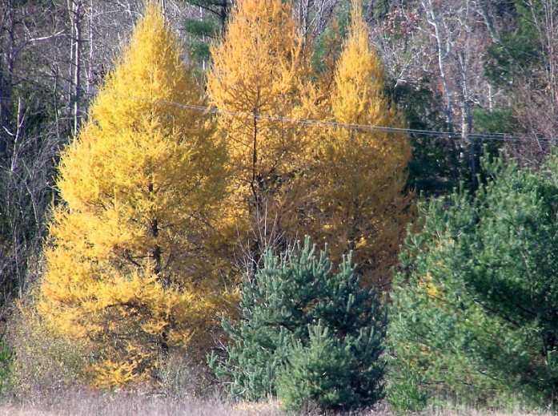
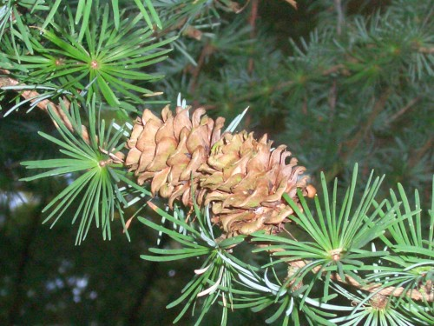
Tamarack (American larch)
Lose their needles each year
Shrub tree found near bogs
Needles grow out of the bark

Slide 16
Maples

Slide 17
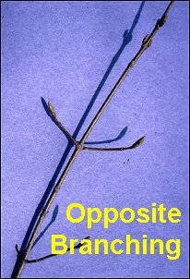
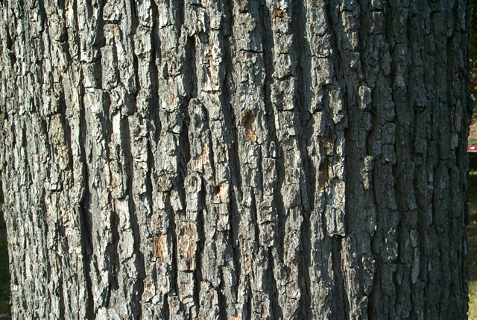
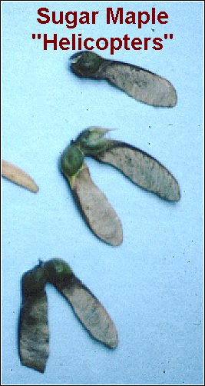
Sugar Maples Acer saccharum
Young trees have smooth light grey bark becoming rough and deeply farrowed into narrow scaly ridges.
Opposite branching

Slide 18
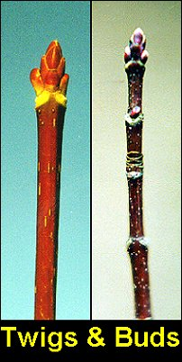
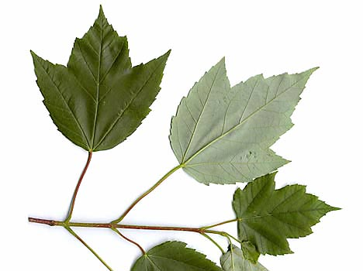
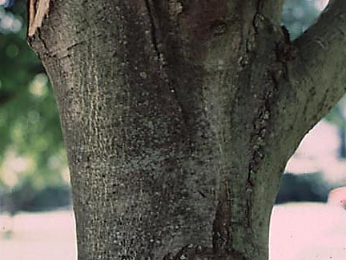
Red Maples Acer rubrum
Red twigs and buds
Leaves have teeth and sharper grooves than the sugar maple
http://www.waterfordvillage.org/graphics/nature/red-maple-bark.jpg

Slide 19
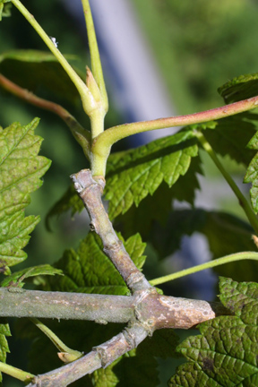
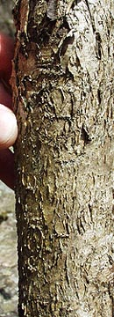
Mountain Maple Acer spicatum
The leaves extend from slender reddish stalks which are usually longer than the leaf itself.
Large shrub or small tree

Slide 20
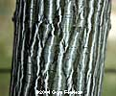
Striped “goosefoot” maple Acer pensylvanicum
Shrub or small tree with striped bark and large characteristic leaves that look like a goose foot

Slide 21
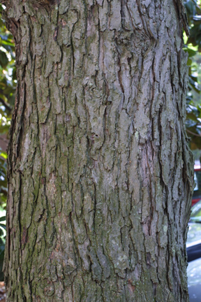
Silver Maple Acer saccharinum
On larger trees, the bark peels in long strips that curls at the ends, giving it a unique shaggy appearance.
Silver Maple grows in moist bottomlands along the shores of rivers, streams, islands and lakes.
Not common to much of the Adirondacks

Slide 22
Other Hardwoods

Slide 23
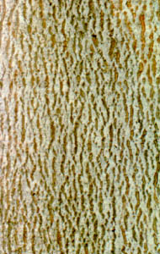
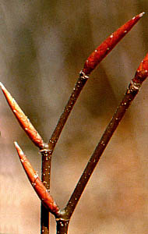
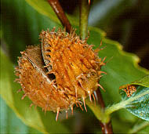
American Beech Fagus grandifolia
Long pointed cigar like buds
Strongly veined leaves end in points and stay on branches through much of winter
Smooth greyish bark
Adult trees produce nuts

Slide 24
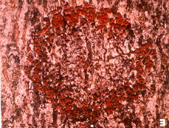
Beech Bark Disease
Caused by a fungus carried by an insect
Around October small red reproductive organs called perithicia can often be found making small circles on the bark of the infected tree.
No known cure for this disease.
Prevention of the beech scales is the only known method of control for beech bark disease.
http://www.upenn.edu/paflora/plantclinic/beechbarkdisease.htm

Slide 25
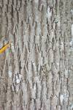
White Ash (Fraxinus americana)
Compound leaves (7 leaflets) with smooth edges
Deeply grooved grey brown bark with diamond shapes

Slide 26
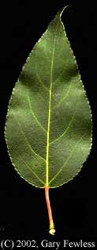
Balsam Poplar Populus balsamifera
Grows in moist soils and river banks
Sun loving, fast growing

Slide 27
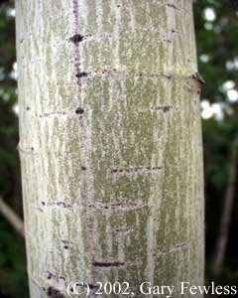
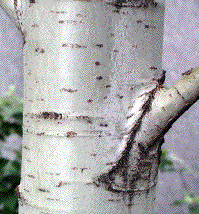
Quaking Aspen Populus tremuloides
Heart shaped leaves quiver in the slightest breeze.
Smooth bark
Early succession sun loving tree
Leaf similar to the large toothed aspen but doesn’t have grooves

Slide 28
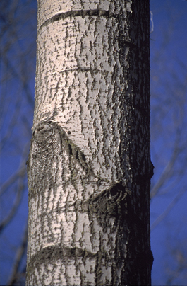
Bigtooth Aspen Populus grandidentata
Medium size tree
Sun loving early successional tree
Grooved leaves
Smooth gray thin bark
http://www.fcps.edu/islandcreekes/ecology/bigtooth_aspen.htm

Slide 29
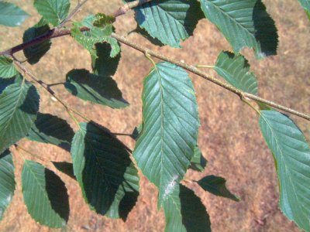
Hophornbeam Ostrya virginiana
Hophornbeam grows best on well-drained slopes and ridges
high shade tolerance
often found in the understorey of mixed to pure hardwood forests.

Slide 30
Hobblebush Viburnum alnifolium
Bush with large opposite leaves
Favor shade and often found in the understory of mixed hardwood stands

Slide 31
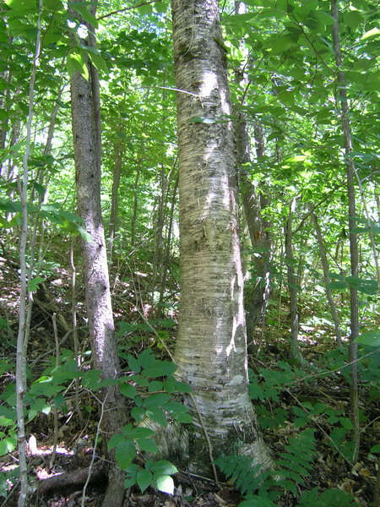
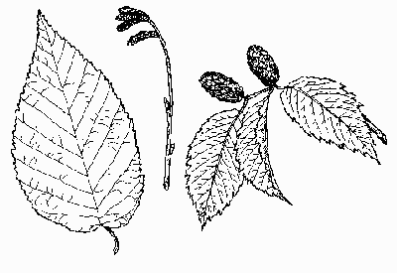
Yellow Birch Betula alleghaniensis
Alternate leaves
New branches when scraped smell like wintergreen

Slide 32
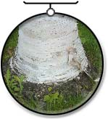
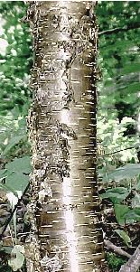
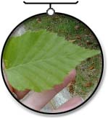
White Birch Betula papyrifera
White bark peels off in sheets

Slide 33
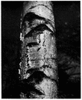
Grey birch Betula populifolia
Mainly in swamps
Large dark “frown lines”

Slide 34
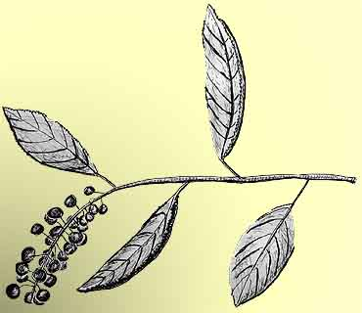
Black Cherry Prunus serotina
Alternate, curved oblong leaves
Scaley bark
Favorite food of black bears

Slide 35
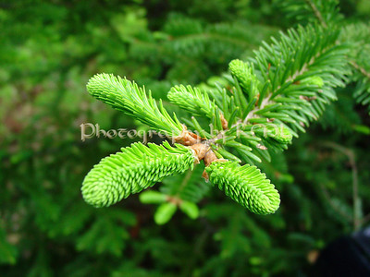
How do trees Grow?
Out and up
Cambium layer contains rapidly dividing cells → increases diameter
Meristematic tissues (tips of branches → increasing height)
http://photographybykml.com/photos/171574964_x5b4N-S.jpg

